Slide 1
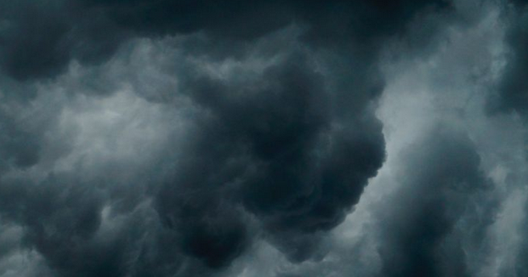
Weather
What is it?

Slide 2

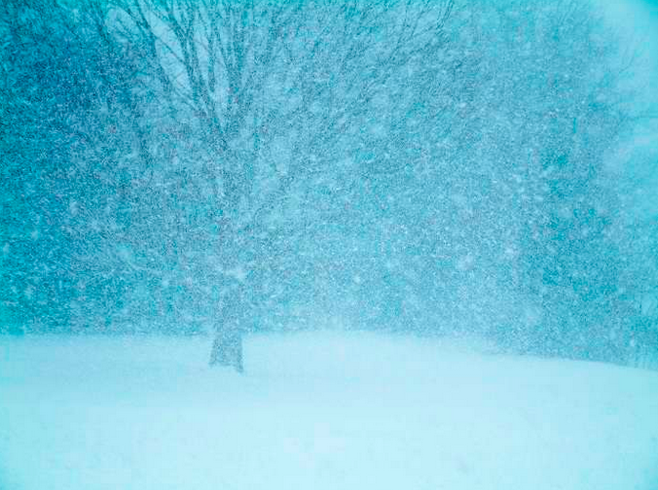
Weather: the conditions in the air above the earth such as wind, rain or temperature especially at a particular time over a particular area.¹

Slide 3
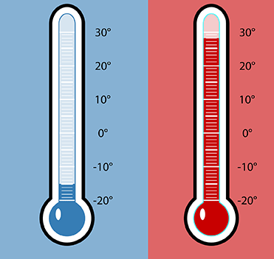
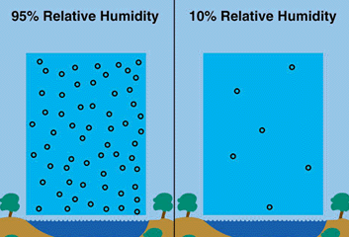
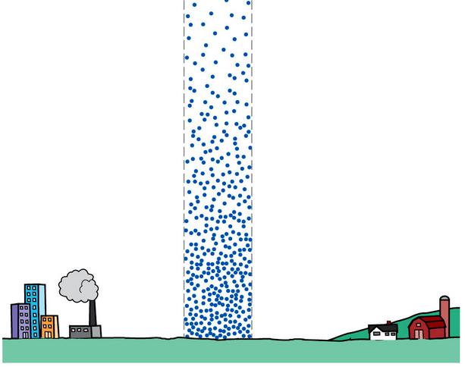

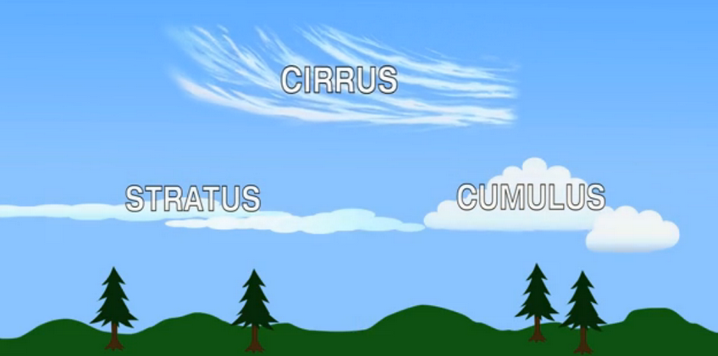
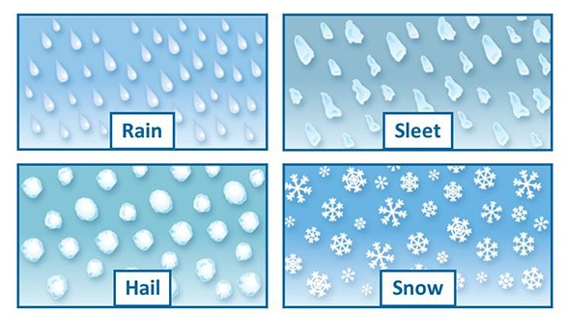
In order to understand weather, we will learn about:
Temperature
Humidity
Air Pressure
Wind
Clouds
Precipitation

Slide 4
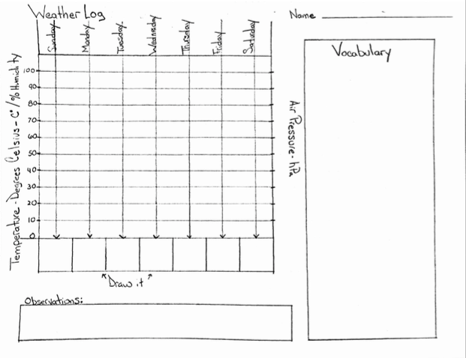
For one month (four weeks), we will keep a Weather Log.
Every day, we will graph the temperature, humidity and air pressure.
Every day, we will draw a picture showing the weather at the time that we are measuring.
Once a week will make observations and write them down.
We will learn about new words and write and draw about them in the vocabulary box.
After four weeks, we will put all graphs together and look at the weather for the whole month.

Slide 5
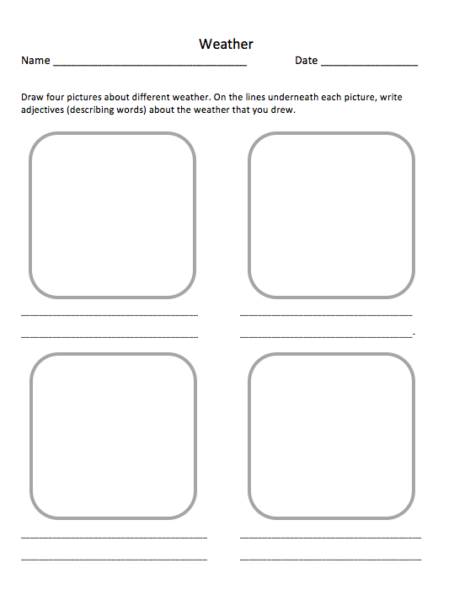
Before we begin, let’s see what we already know about weather.
Draw four pictures about different kinds of weather.
On the lines beneath each picture, write adjectives (describing words) about the weather that you drew.

Slide 6
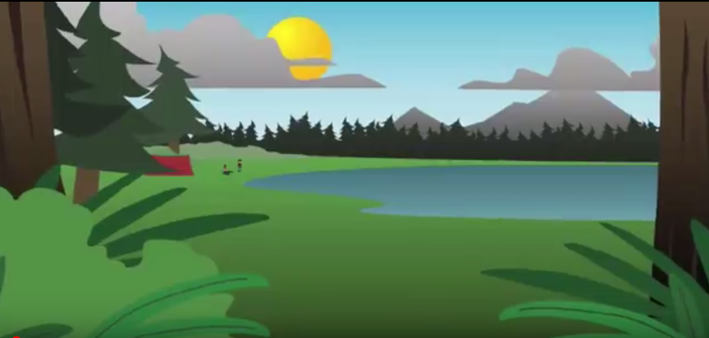
Watch the video:
https://www.youtube.com/watch?v=XirAUvS_29I

Slide 7
Weather and Climate
Discussion Questions
What things can cause the weather to change?
What is heavier, cool air or warm air?
What is the difference between climate and weather?
How do clouds form?
What is the job of a meteorologist?

Slide 8
Temperature
Temperature Is a measurement of heat.
Heat is a form of energy that a substance has because of the movement of it’s atoms or molecules.
We measure temperature with a thermometer.

Slide 9
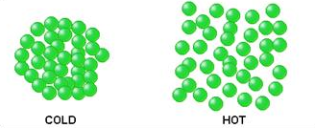
When something is cold, it’s molecules or smallest parts are moving slowly and are close together. When it is hot, the molecules are moving quickly and are far apart.

Slide 10
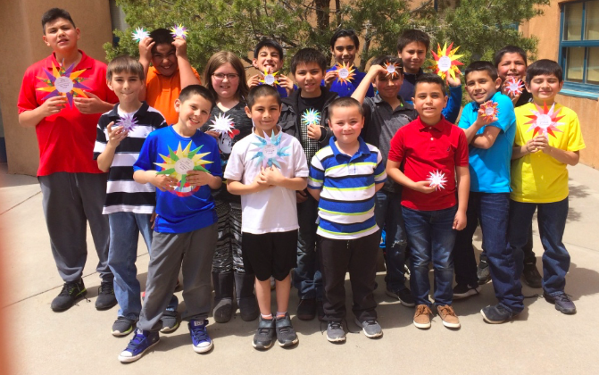
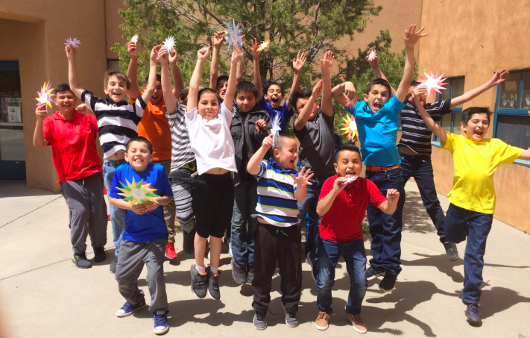
Everyone stand close together and move slowly.
Let’s try it!
Now if everyone starts to move around, you will take up more space.
Molecules with little heat energy
Molecules with lots of heat energy.

Slide 11

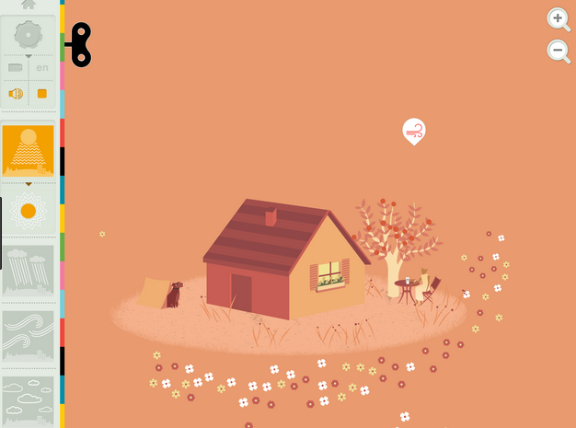


Learning with Technology
Using an iPad, go to the Tinybop Weather app.
Open the app and tap on your account.
Touch the key and on the left side click on the sun symbol
Tap on the white circles on the dog, window or table to
see more details. Change the temperature with the thermometer
and observe what happens. Tap on the molecules symbol
to see how the molecules are acting differently when it is
warm and cold.
Change the temperature by tapping and dragging on thewarm or
cold air symbols and observe what changes.

Slide 12
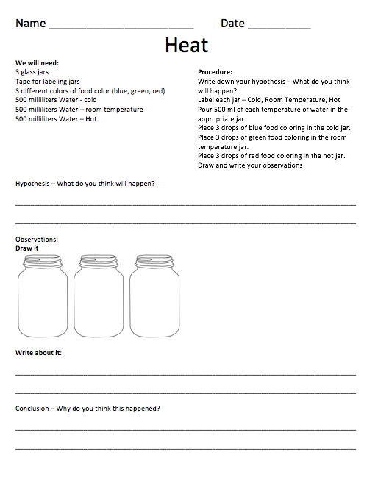
Heat Activity
In order to understand that molecules are moving faster when they are hot, we are going to observe what happens when we put food coloring in three jars of water with different amounts of heat energy.
We will need:
3 glass jars
Tape for labeling jars
3 different colors of food color (blue, green, red)
500 milliliters Water - cold
500 milliliters Water – room temperature
500 milliliters Water – Hot
Procedure:
Write down your hypothesis – What do you think will happen?
Label each jar – Cold, Room Temperature, Hot
Pour 500 ml of each temperature of water in the appropriate jar
Place 3 drops of blue food coloring in the cold jar.
Place 3 drops of green food coloring in the room temperature jar.
Place 3 drops of red food coloring in the hot jar.
Draw and write your observations after 5 minutes.

Slide 13

Make a video of your experiment
Use the FlipGrid app on the iPad and make a video about your experiment.
The password for the grid is: ranchos1
The topic is titled: Heat Activity
Be sure to:
Introduce yourself and your experiment
Explain your procedure
State your hypothesis
Video the results
Explain your observations
State your conclusion

Slide 14
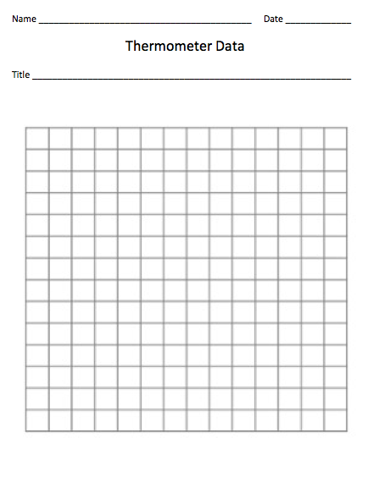
Thermometers
Now let’s learn how to use our thermometers.
-We will measure the temperature of different things in the school and make a bar graph to show our results.
-These thermometers are glass and can break easily, so be careful. If yours breaks, tell me right away.
-Your thermometer will need at least 3 minutes to accurately measure the temperature, so use a timer.
-If you are holding onto the thermometer, it will measure your temperature, so carefully place your thermometer in or on whatever you are going to measure.
-Use the thermometer data graph to make your bar graph.
-measure the temperature of at least 10 things.

Slide 15
Temperature and Heat Discussion Questions
What is temperature?
What is heat?
How can we know how much heat energy something has?
Why did the food color in the hot water mix faster than in the other jars?
In the Tinybop Weather app, what were the air molecules doing when
they were hot and cold?

Slide 16

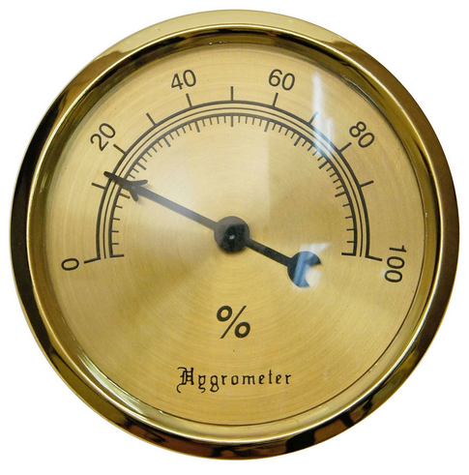
Humidity
Humidity is a measurement of how wet the air is.
The air around us has water vapor in it, but we cannot see it because it is a gas.
This water vapor is what we measure when we measure humidity.
We measure humidity with a tool called a hygrometer.
The amount of water in the air affects what kind of weather we will have.

Slide 17

Learning with Technology
Using an iPad, go to the Tinybop Weather app.
Open the app and tap on your account.
Tap on the key and make sure that none of the symbols in
the left columns are highlighted. This will allow
you to see how all of the elements of weather
interact.
Tap on the water to see the water vapor. It
Will look like small white circles.
Observe what happens to that humidity.
Tap on the land to see the water vapor.
Observe what happens to that humidity.

Slide 18
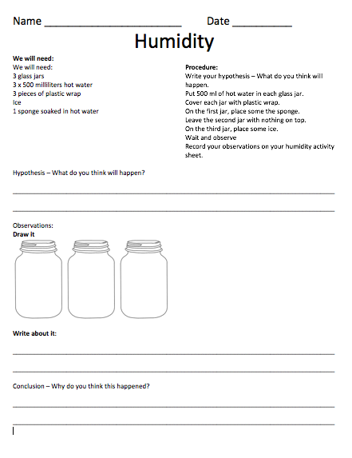
Humidity Activity
How does temperature affect the amount of water vapor air can hold?
We will need:
3 glass jars
3 x 500 milliliters hot water
3 pieces of plastic wrap
Ice
1 sponge soaked in hot water
Procedure:
Write your hypothesis – What do you think will happen.
Put 500 ml of hot water in each glass jar.
Cover each jar with plastic wrap.
On top of the first jar, place the sponge.
Leave the second jar with nothing on top.
On the third jar, place some ice.
Wait and observe
Record your observations on your humidity activity sheet.

Slide 19
Make a video of your experiment
Use the FlipGrid app on the iPad and make a video about your experiment.
The password for the grid is: ranchos1
The topic is titled: Humidity Activity
Be sure to:
Introduce yourself and your experiment
Explain your procedure
State your hypothesis
Video the results
Explain your observations
State your conclusion

Slide 20
Humidity Discussion Questions
What is humidity.
What does water vapor look like?
Which of the jars in our humidity activity formed the most water droplets? Why?

Slide 21
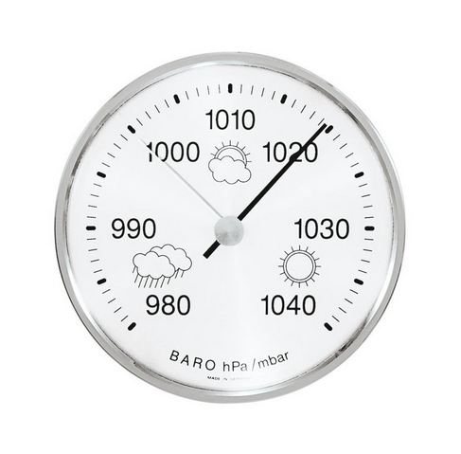
Air Pressure
Air pressure is the weight of air molecules pressing down on the Earth.
The air around you has weight, and it presses against everything it touches.
That pressure is called atmospheric pressure, or air pressure.
We measure air pressure with a barometer.

Slide 22
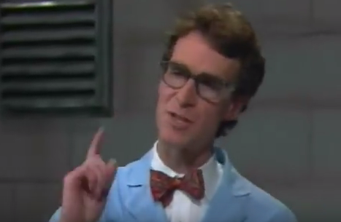
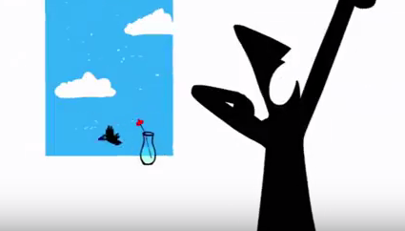
Watch the videos
https://www.youtube.com/watch?v=QeAp3CuGjk8&feature=youtu.be
And
https://www.youtube.com/watch?v=VDf00z8sMFw

Slide 23
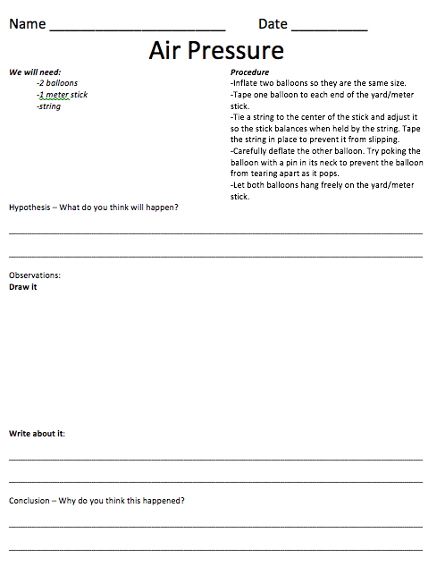
Air Pressure Activity
We will need:
-2 balloons
-1 meter stick
-string
Procedure
  -Inflate two balloons so they are the same size.
  -Tape one balloon to each end of the yard/meter stick.
  -Tie a string to the center of the stick and adjust it so the stick balances when held by the string. Tape the string in place to prevent it from slipping.
  -Carefully deflate the other balloon. Try poking the balloon with a pin in its neck to prevent the balloon from tearing apart as it pops.
  -Let both balloons hang freely on the yard/meter stick.

Slide 24
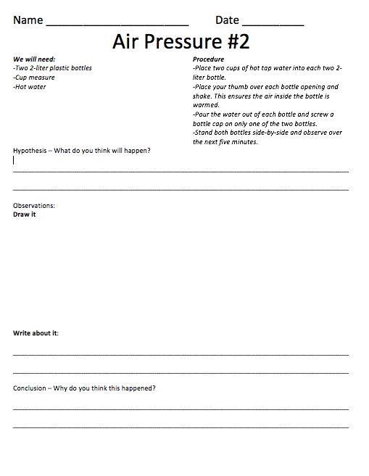
Air Pressure Activity #2
We will need:
-Two 2-liter plastic bottles
-Cup measure
-Hot water
Procedure
Place two cups of hot tap water into each two 2-liter bottle.
Place your thumb over each bottle opening and shake. This ensures the air inside the bottle is warmed.
Pour the water out of each bottle and screw a bottle cap on only one of the two bottles.
Stand both bottles side-by-side and observe over the next five minutes.

Slide 25
Make a video of your experiment
Use the FlipGrid app on the iPad and make a video about one of your air pressure experiments.
The password for the grid is: ranchos1
The topic is titled: Air Pressure Activity
Be sure to:
Introduce yourself and your experiment
Explain your procedure
State your hypothesis
Video the results
Explain your observations
State your conclusion

Slide 26
Air Pressure Discussion Questions
Does air have weight? How do you know?
Can air pressure have a lot of force?
Why don’t we get crushed by air pressure?
How do our bodies use air pressure to stay alive?
How does air pressure affect the formation of clouds?

Slide 27
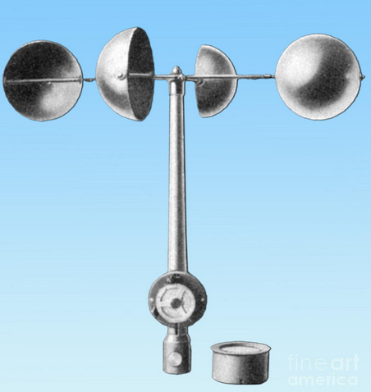
Wind
Wind is the movement of air outside.
Air molecules are always moving around which causes
wind and affects the weather.
We measure wind with an anemometer.

Slide 28


Learning with Technology
Using an iPad, go to the Tinybop Weather app.
Open the app and tap on your account.
Tap on the key and then tap the wind symbol.
Tap on the white circle on the tornado to see
more details. Make the storm bigger by swiping up to create more wind that moves up.
Tap on the updraft symbol to see how the air is moving.
Observe what happens when you tap on the
Anemometer.
Tap on the white circle on the hurricane. Explore and observe.

Slide 29
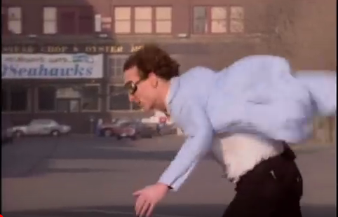
Watch the video
https://www.youtube.com/watch?v=uBqohRu2RRk

Slide 30
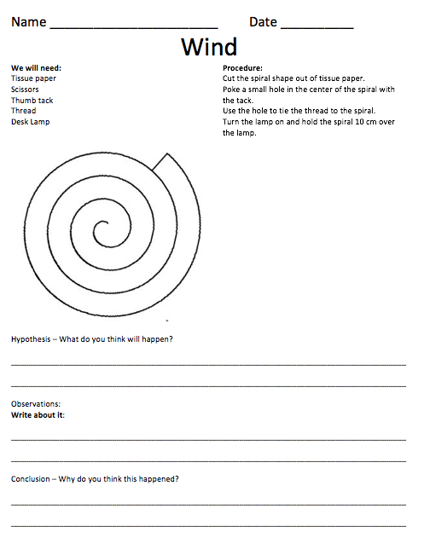
Wind Activity
We will need:
Tissue paper
Scissors
Thumb tack
Thread
Desk Lamp
Procedure:
Cut the spiral shape out of tissue paper.
Poke a small hole in the center of the spiral with the tack.
Use the hole to tie the thread to the spiral.
Turn the lamp on and hold the spiral 10 cm over the lamp.

Slide 31
Make a video of your experiment
Use the FlipGrid app on the iPad and make a video about your experiment.
The password for the grid is: ranchos1
The topic is titled: Wind Activity
Be sure to:
Introduce yourself and your experiment
Explain your procedure
State your hypothesis
Video the results
Explain your observations
State your conclusion

Slide 32
Wind Discussion Questions
What is wind?
What are some things that cause wind?
How does wind affect us?
How does wind affect the weather?

Slide 33
Clouds
A cloud is a white or gray mass of very small drops of water or ice that float in the sky.
Clouds come in many shapes and sizes and greatly affect what our weather will be like.

Slide 34
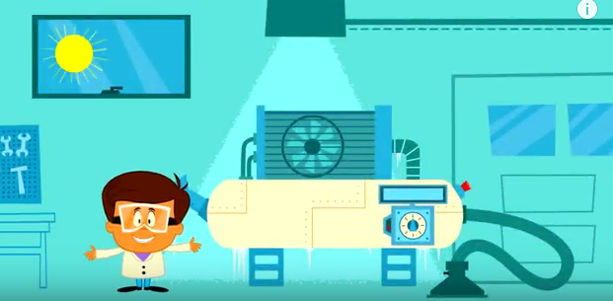
Watch the video;
https://www.youtube.com/watch?v=0cKJr3-bJg4

Slide 35

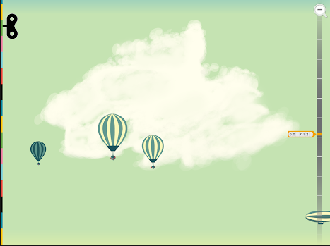
Learning with Technology
Using an iPad, go to the Tinybop Weather app.
Open the app and tap on your account.
Tap on the key and tap on the cloud symbol.
Make clouds by tapping and swiping at
different altitudes.
How are the clouds
different?

Slide 36
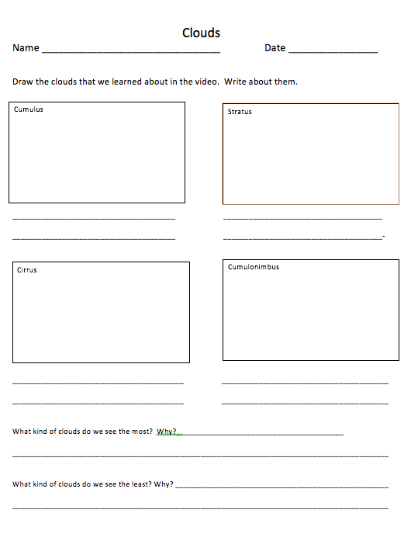
Cloud Activity
On the Cloud Activity sheet, draw the different kinds of clouds that were mentioned in the video. Then write some important facts about each type of cloud.

Slide 37
Cloud Discussion Questions
What happens to turn water vapor into a cloud?
Where does the water vapor come from that makes clouds?
What effects do clouds have on temperature?
Compare and contrast cirrus, stratus, and cumulus clouds

Slide 38
Precipitation
Precipitation is water that falls from the clouds toward the ground.
Types of precipitation include rain, sleet, hail and snow.

Slide 39

Watch the video:
https://www.youtube.com/watch?v=z5G4NCwWUxY

Slide 40
Learning with Technology
Using an iPad, go to the Tinybop Weather app.
Open the app and tap on your account.
On the home page of the app, tap to change
humidity, move the sun, and change wind and
observe what happens.

Slide 41
Precipitation Discussion Questions
Where does precipitation come from?
What causes precipitation to fall?
What causes snow rather than rain to fall?
Why do some tornados and hurricanes becomes so powerful?

Slide 42
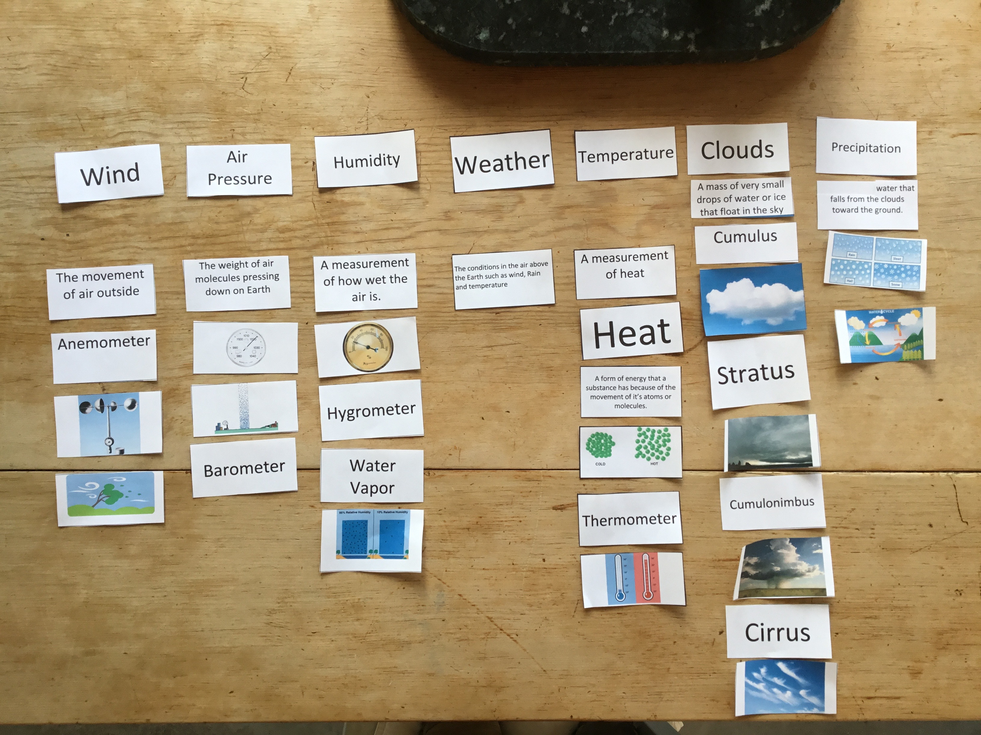
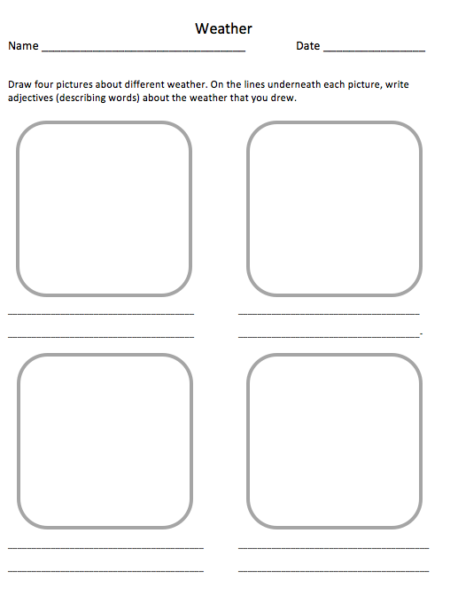
Assessment
Play the Weather matching game.
Once you place your card and your
partner agrees. Use a complete
sentence to explain your understanding.
Draw and write about 4 weather ideas that
you learned about.

Slide 43
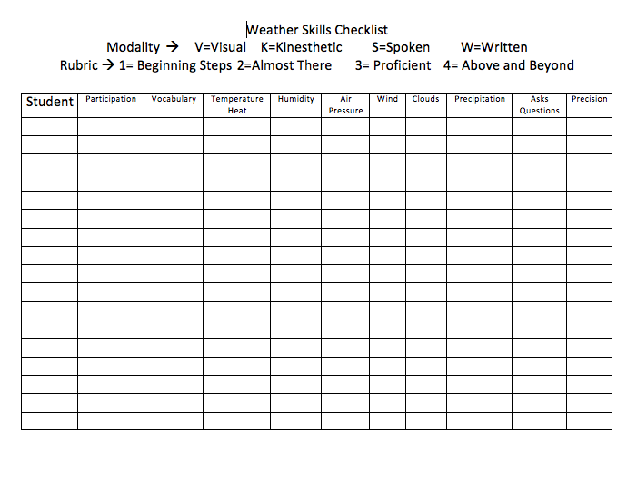
Skills Checklist

Slide 44
Standrads
3-ESS2-1 Earth's Systems
Represent data in tables and graphical displays to describe typical weather conditions expected during a particular season.
4-PS3-2 Energy
Make observations to provide evidence that energy can be transferred from place to place by sound, light, heat, and electric currents.
5-PS1-1 Matter and Its Interactions
Develop a model to describe that matter is made of particles too small to be seen.
MA.5
Represent and interpret data
MA.3.
Solve problems involving measurement and estimation of intervals of time,
liquid volumes, and masses of objects.
LA.5.SL.5.1
Engage effectively in a range of collaborative discussions (one-on-one, in groups, and teacher-led) with diverse partners on grade 5 topics and texts, building on others’ ideas and expressing their own clearly.
LA.5.RI.5.7
Draw on information from multiple print or digital sources, demonstrating the ability to locate an answer to a question quickly or to solve a problem efficiently.

Slide 45
Resources
Cambridge Dictionary
Youtube – Weather and Climate - Sriddle8119
Nationalgeographic.org
Tinybop app – Tinybop Inc.
Flipgrid app – Flipgrid Inc.
Bill Nye – Air Pressure
Ted Ed - Dan Quin - How Heavy is Air?
Climate and Water Consortioum – New Mexico Tech - cwc.nmt.edu
Youtube - Bill Nye the Science Guy on Wind
Youtube – Cartoons for Kids – All About Clouds
Youtube – Crash Course for Kids – The Great Aqua Adventure Crash Course #24.1
Common Core Math and Language Arts Standards
Next Generation Science Standrads

